Slide 1
Setting the table: fact, fiction and foundations
to alleviate hunger - it’s complicated
Dr. Don Buckingham and Mrs. Julia (Buckingham) Sáez
Ottawa, CANADA
http://www.free-powerpoint-templates-design.com

Slide 2
Importance of worldview
Ours is a Christian one …
based on hope, humility & community

Slide 3
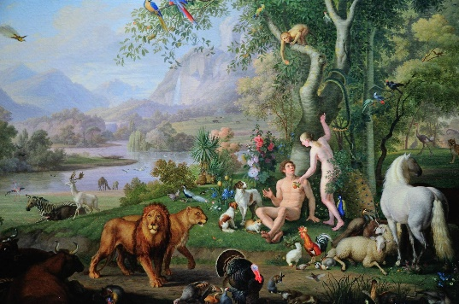
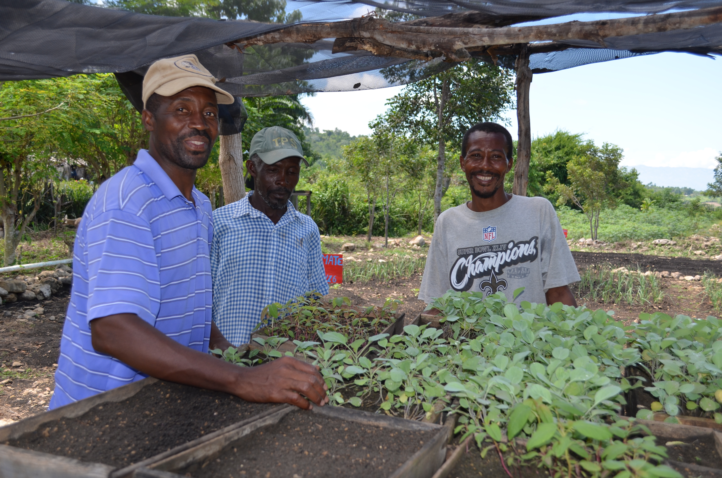
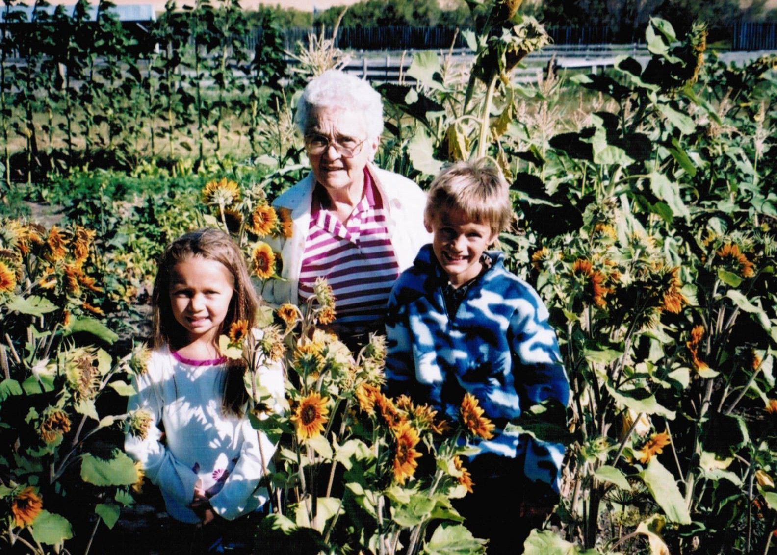
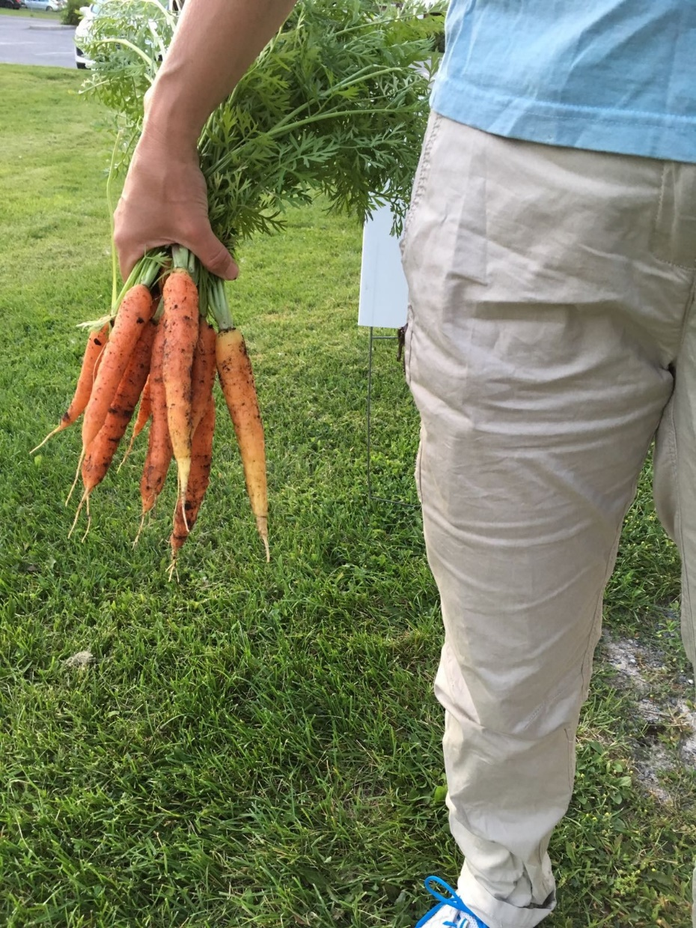
Four Gardens

Slide 4
Overview of session
A
It’s complicated!
Houston, we have a problem…
Is production the problem?
B
Producing without overheating
C
Is consumption the problem?
Waste it or waist it – tough choices
D
Food insecurity
In its many forms and locations
E
Start simple!
So, where do we start to clean up this mess?

Slide 5
Food production
… and its consequences: PACE and POLLUTION

Slide 6
World Population Timeline
It’s getting crowded in here (almost two new Canadas are added to the world every year (70-80 million))
0
1800
1950
2024
2050
8,200,000,000
200,000,000
1,000,000,000
2,500,000,000
10,000,000,000
India # 1/2 – 1.41 B
China # 1/2 – 1.41 B
USA # 3 – 0.35 B
Indonesia # 4 – 0.28 B
Pakistan # 5 – 0.25 B
Nigeria # 6 – 0.23 B
Brazil # 7 – 0.21 B

Slide 7
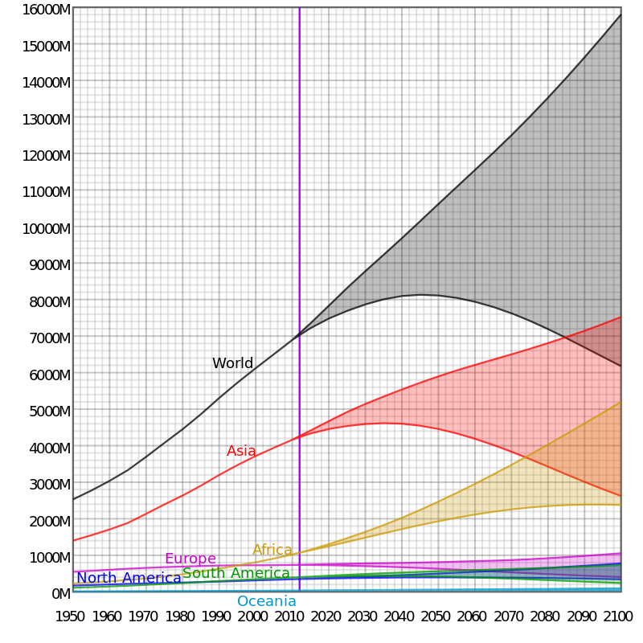
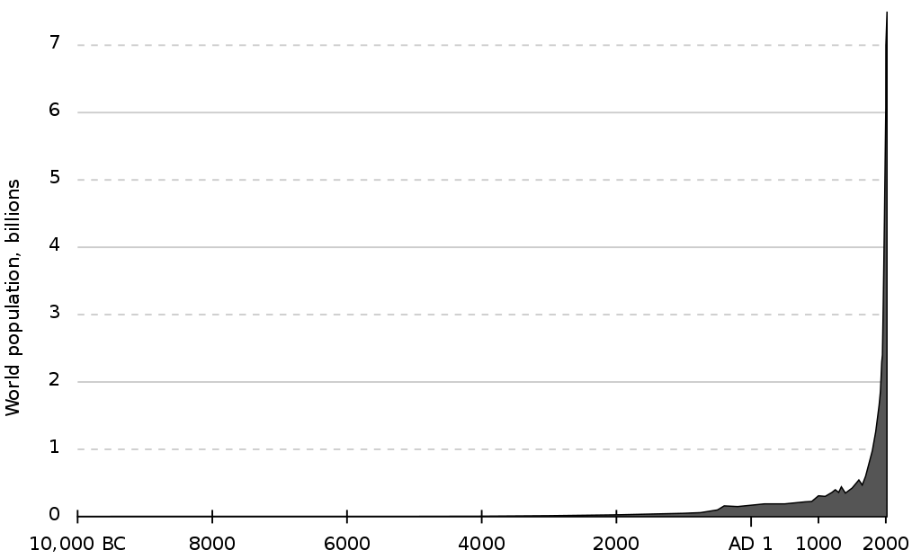
World population evolution

Slide 8
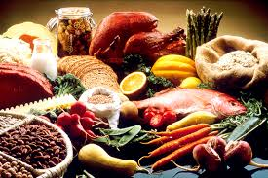

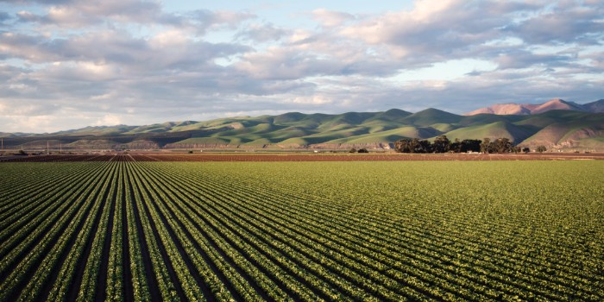

World Food Production: Abundance?
Enough food now
More food needed
We can grow more
“Magic bullets” can help
If all food currently
produced was equally distributed, every
person would get
around 3000 calories
per day
We can extensify (find more places to grow
food) and intensify
(increase food crop
yields)
We will need a 40-70% increase from today’s
production to meet
needs of 10B mouths in 2050
Technology
Information
Biology
Chemistry
Physics

Slide 9
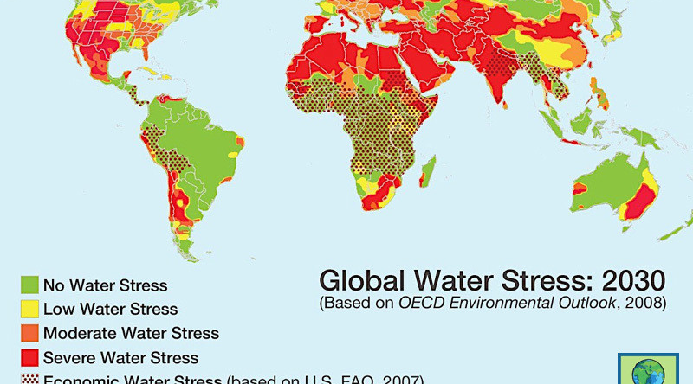
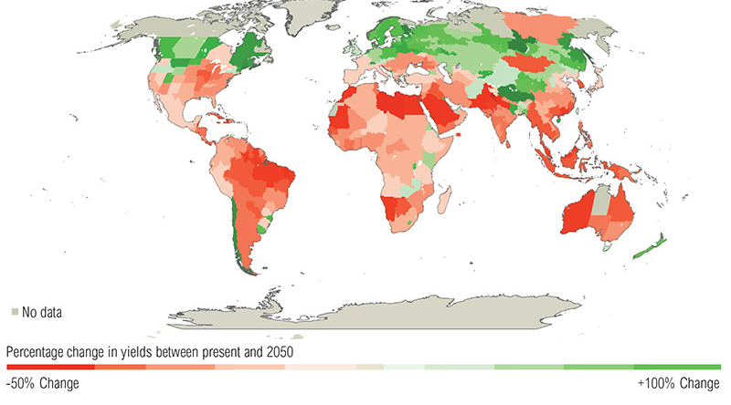
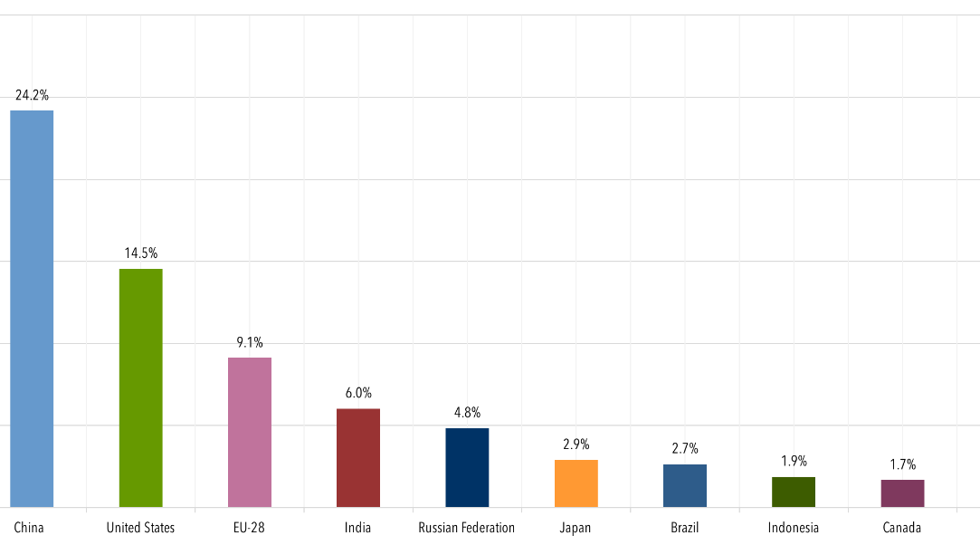
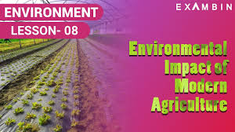
But is feeding ourselves killing the planet?

Slide 10

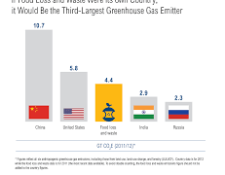
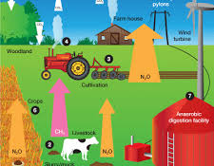
Agriculture and Food’s GHG Footprint
Total World GHG emissions
Electricity and Heat - 14 billion tonnes
45.3 billion tonnes (gigatons) of CO2e
Transportation - 7 billion tonnes
Agriculture – 5 billion tonnes
Manufacturing and Const - 6 billion tonnes
Food Waste
USA – 75%
3-4 billion tonnes of C02e
Mexico – 15%
North America’s share - .2 billion tonnes
Canada – 10%
Canada’s profile
Livestock – 55% (fermentation & manure)
Canada’s total - .7 billion tonnes
Canadian agr & food - .07 billion tonnes
Crops – 45% (soil losses & chem fertilizers)

Slide 11
Food consumption
… and its consequences WANT and WASTE

Slide 12
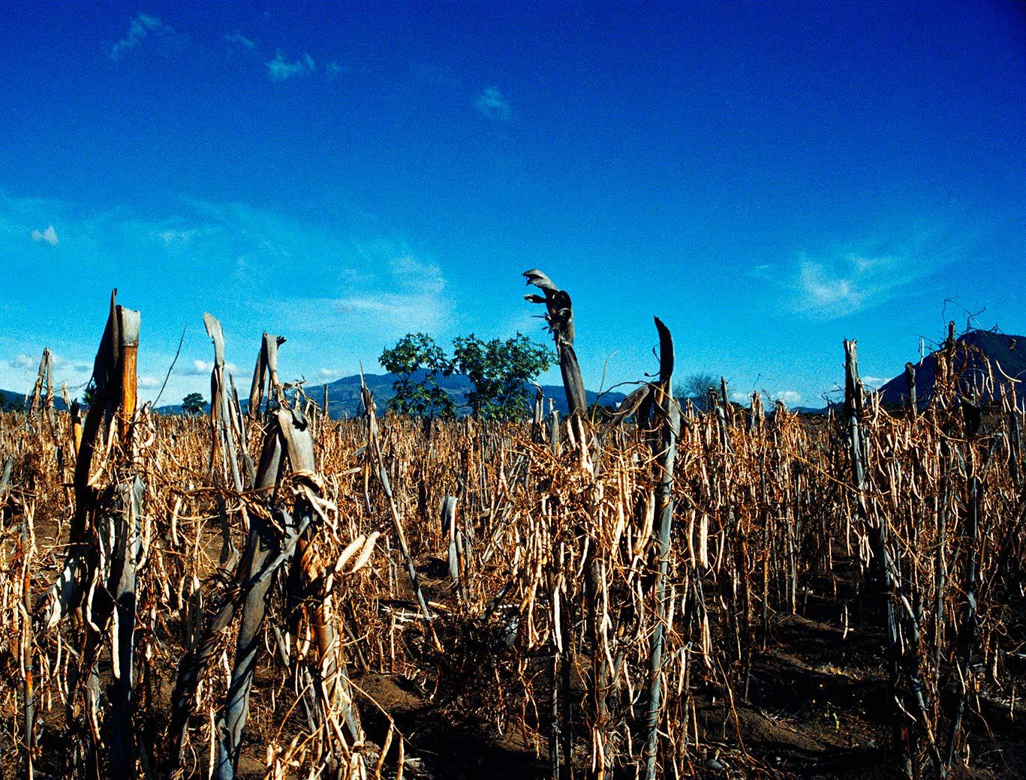

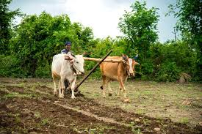
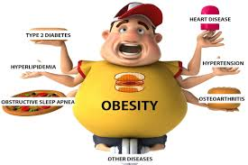
World Food Consumption: Scarcity?
Multiple
challenges
People are
still hungry
Farmers are among
the most vulnerable
The other problems: obesity and waste
Conflict, economic
disruptions, extreme
weather, rising cost of
living, wealth inequities and discrimination
Up to 757M people
are still facing hunger, or 1 in 11 people worldwide; total food
insecure is 2.33B
500M smallholder
households (or
about 2B people)
globally cultivating less than five acres
Over 1B people worldwide are obese; AND 20% of food
produced is lost or wasted
globally (about 1B meals per
day or US$1T annually)

Slide 13
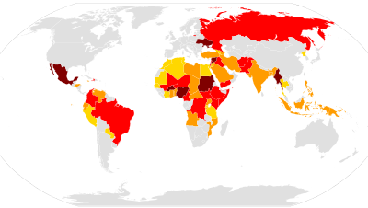
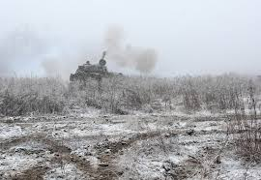
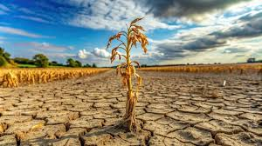
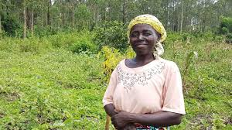
Unpacking food insecurity
Some primary causes
Conflict
Elec
Trans
Major wars, wars, conflicts, clashes
1 in 4 live in conflict-affected countries
Man
Heatwaves across South & Southeast Asia
Brazil, UAE, Kenya and Spain rains & flooding
Wildfires in Canada
Cyclones in Bangladesh & West Bengal
Tornadoes and hurricanes in the USA
Extreme weather
Examples just from 2024 →
3.5B are vulnerable to extreme events
Cost of living impacts
In 2022, 89% of the least developed countries had food inflation of 5-32%: for example, Cambodia 5%; Guatemala 10%; Burundi 21%, Ethiopia 32% (Canada’s rate for food was 7%)
Disproportionate effects on women, the
poor, disabled, and religious minorities
100M more are being pushed into poverty

Slide 14
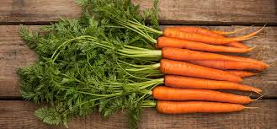
Are there solutions? – start simple
From despair to hope one carrot at a time

Slide 15
It’s easy to get overwhelmed
“Don’t try to eat an elephant in one bite”
Option A - Individual action
Option
A
B
D
Option D – International social and economic action
Option B – Science and “Tech” action
Option
Option
C
Option
Option E – all of the above
Option C – Local/national social and economic action

Slide 16
Starting small – Option A (at home)
From your house to the ends of the earth
Being
Doing
STOP – think where your food comes from and give thanks
LOOK – find out more about those people who produce your food
FEEL/PRAY – for a blessing and a strengthening of all those who produce food AS WELL as all those who struggle to have enough food
ENGAGE – how can you lean into a passion for food work?
MAKE FOOD – how can you make and eat food more responsibly?
WASTE LESS – how can you plan to eat fully what you buy?

Slide 17
Getting techy – Option B
From Ottawa/Nairobi/Lima to the ends of the earth
Being
Doing
STOP – think about what technology you have accepted that you were once skeptical about
LOOK – into some of the solutions that are coming onstream to tackle food production and food insecurity
UNDERSTAND – that new ideas might be better than “same-old” ones
TAKE STOCK – does your line of work give you an avenue to speak into food tech issues?
EMBRACE A NEW IDEA – can you adopt or fund new ideas?
JOIN A COMMUNITY – who can you work together with?

Slide 18
Walking the halls of power – Options C& D
From Ottawa to the ends of the earth
Locally, Nationally
Internationally
STOP – think about what structural obstacles limit solutions to food production and food insecurity problems
LOOK – into some of the policies that might be implemented to tackle food production and insecurity problems
ACT – when your job, NGO, or church gives you a voice to act locally/nationally
GENEROSITY – which communities and policies can you support to combat food insecurity?
WORK FOR PEACE – can you engage or support works for peace?
NETWORK and SERVE – where might you be able to roll up your sleeves and serve the vulnerable?

Slide 19
Grace-changer…
For God so loved the world that he gave his one and only Son

Slide 20
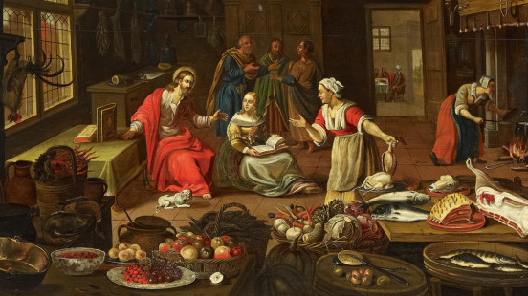
Jesus does not invite us to private banquet
But one served for all with grace, reconciliation, food, and fellowship

Slide 21
Thank you
edonbuckingham@gmail.com
+01 613-889-8804
+41 76 690 43 98
jsaez@foodgrainsbank.ca

