Slide 1

For the Love of Food: Pondering Christmas,
Abundance and Scarcity
Dr. Don Buckingham
Mrs. Julia (Buckingham) Sáez
December 3, 2024

Slide 2
— Genesis 27:28
May God give you heaven’s dew and earth’s richness— an abundance of grain and new wine.

Slide 3
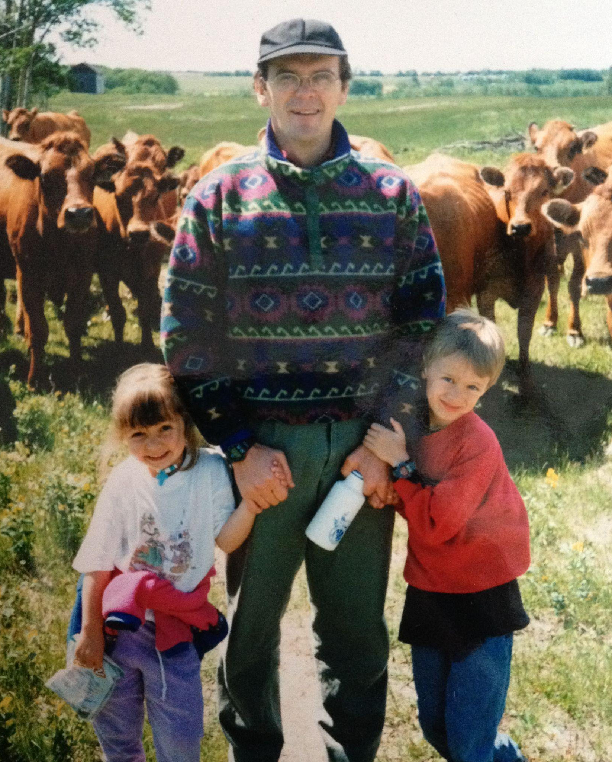
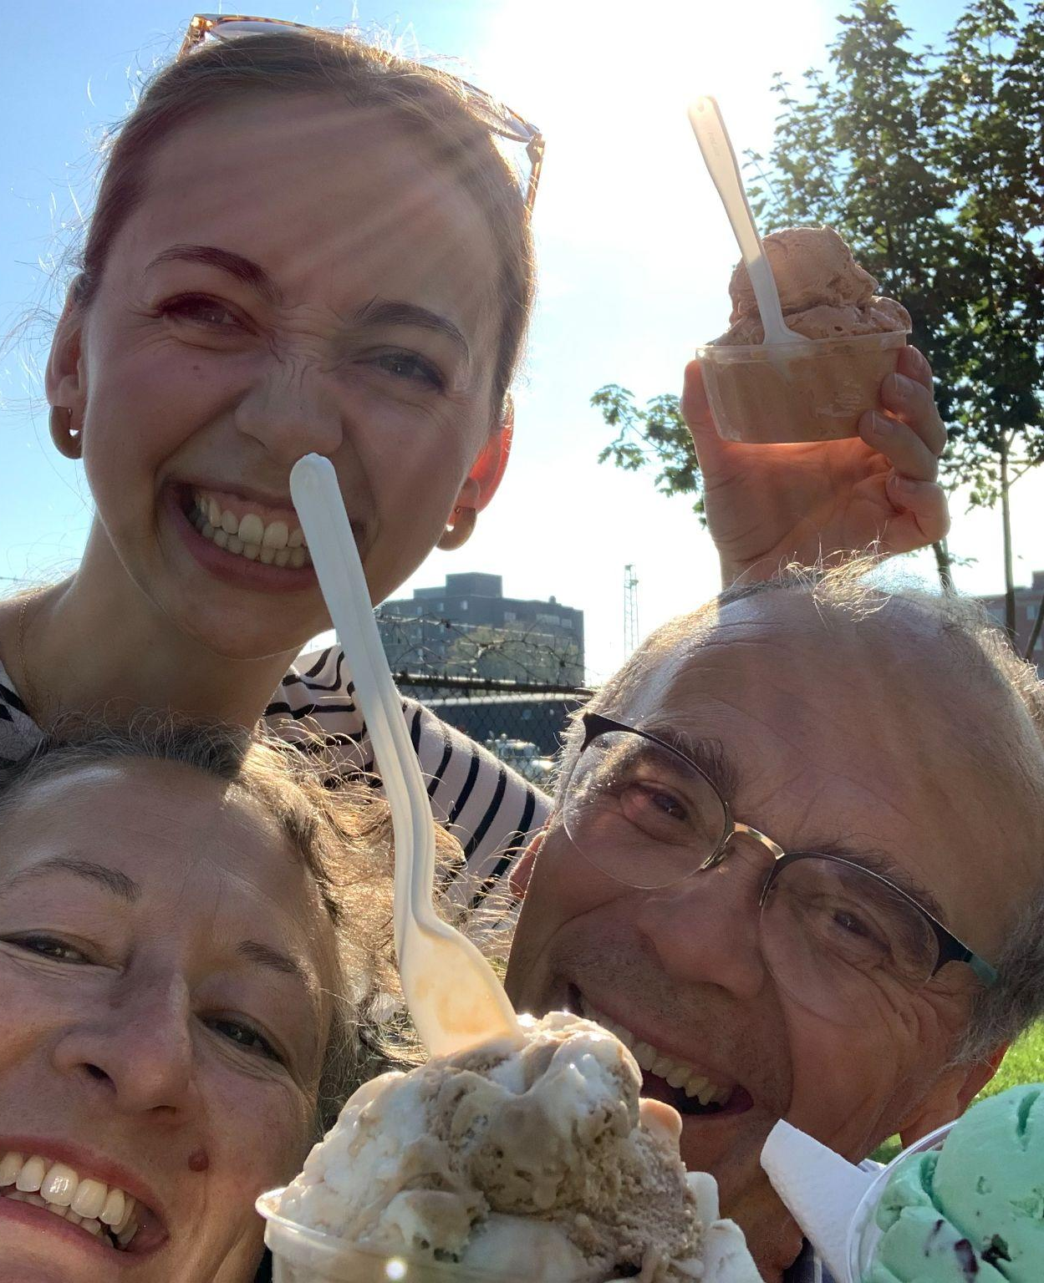
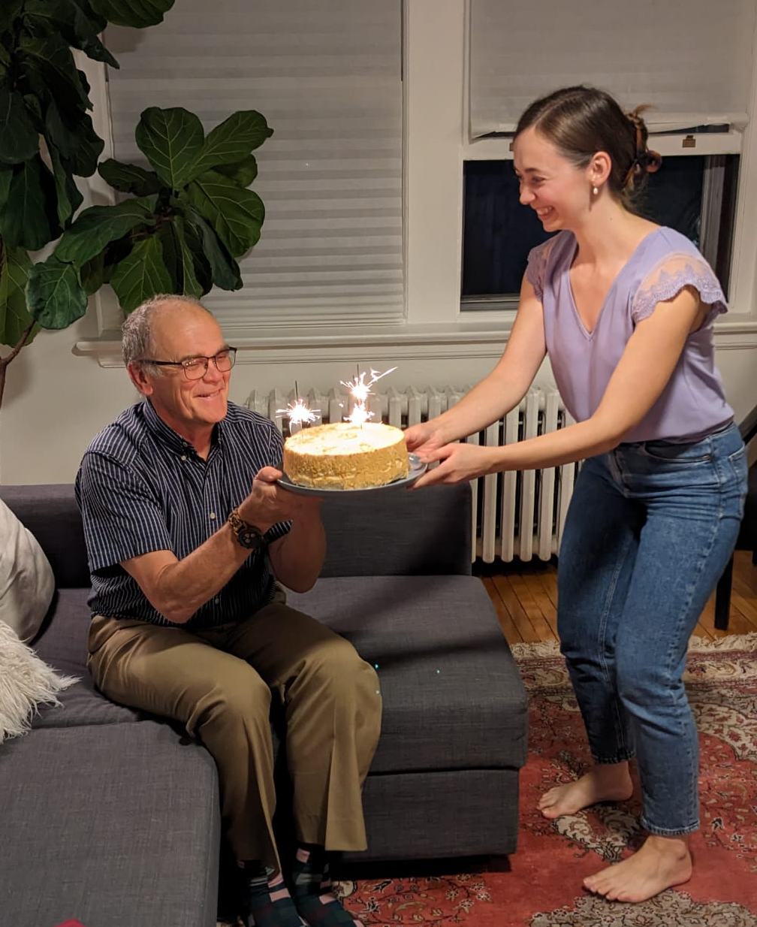
Our story – a winding ag & food journey
Food as
Food as
Food as
Family
Play
Celebration

Slide 4
8,200,000,000
People on the planet
Souls among us
Earthly sojourners
Fellow image-bearers

Slide 5
World Population Timeline
It’s getting crowded in here … almost two new Canadas are
added to the world every year (70-80 million)
0
1800
1950
2024
2050
200,000,000
1,000,000,000
2,500,000,000
8,200,000,000
10,000,000,000
India # 1/2 – 1.41 B
China # 1/2 – 1.41 B
USA # 3 – 0.35 B
Indonesia # 4 – 0.28 B
Pakistan # 5 – 0.25 B
Nigeria # 6 – 0.23 B
Brazil # 7 – 0.21 B

Slide 6
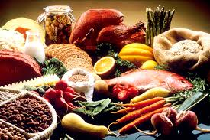

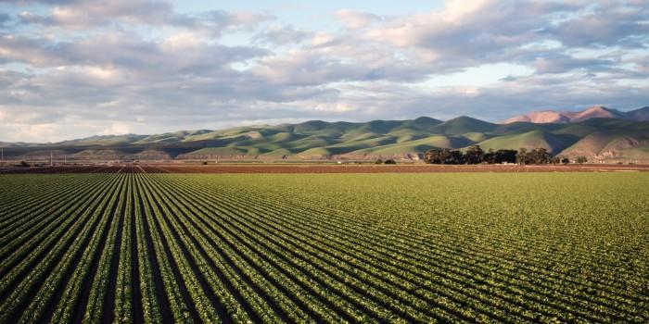

World Food Production: Abundance?
Enough food now
More food needed
We can grow more
“Magic bullets” can help
If all food currently produced was equally distributed, every person would get around 3000 calories per day
We will need a 40-70% increase from today’s production to meet needs of 10B mouths in 2050
We can extensify (find more places to grow food) and intensify (increase food crop yields)
Technology
Information
Biology
Chemistry
Physics

Slide 7
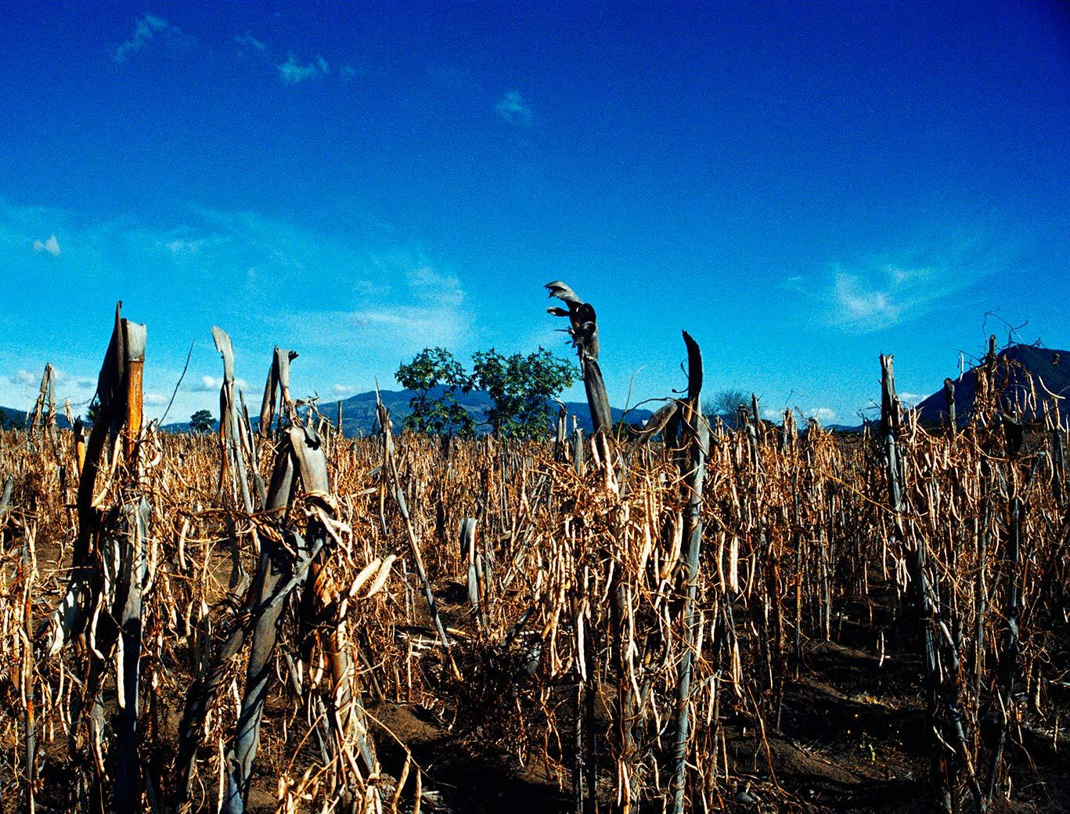


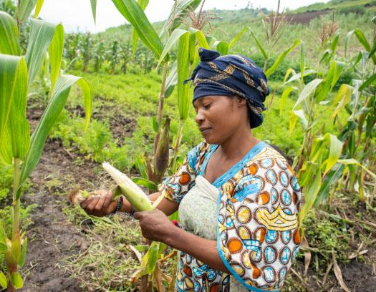
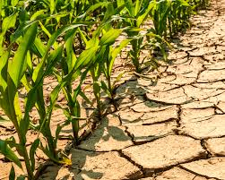
World Food Consumption: Scarcity?
Multiple challenges
People are still hungry
Farmers are among the most vulnerable
Is there hope?
What can we make of this see-sawing between abundance and scarcity?
Economic disruptions, conflict, extreme weather, rising cost of living
Up to 757M people are still facing hunger, or 1 in 11 people worldwide
Over 1 B people earn their living from work in the food system

Slide 8

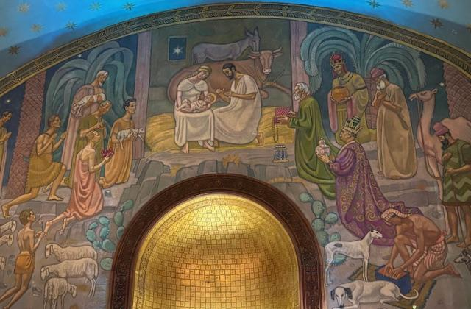
Hope moved into the neighbourhood
The Word became flesh and blood,
and moved into the neighbourhood.
We saw the glory with our own eyes,
the one-of-a-kind glory,
like Father, like Son,
Generous inside and out,
true from start to finish.
- John 1:14

Slide 9

Recipe for a Great Feast
INGREDIENTS
RESULTS
-Isaiah 25:6-8
Eternity
8.2 B portions
Needs grace and hope
But here on this mountain, God-of-the-Angel- Armies will throw a feast for all the people of the world, a feast of the finest foods, a feast with vintage wines, a feast of seven courses, a feast lavish with gourmet desserts.
And here on this mountain, God will banish the pall of doom hanging over all peoples, the shadow of doom darkening all nations. Yes, he’ll banish death forever. And God will wipe the tears from every face. He’ll remove every sign of disgrace from his people, wherever they are.

Slide 10
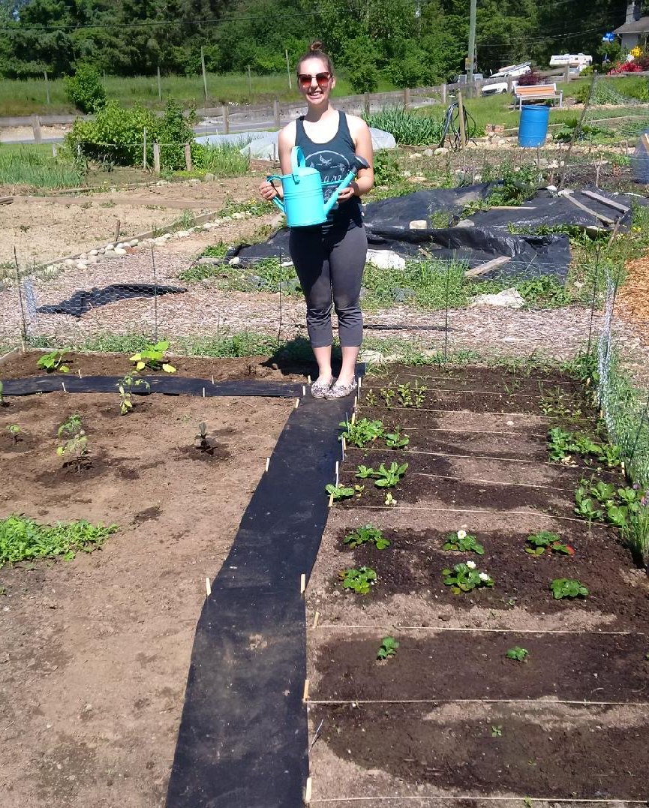
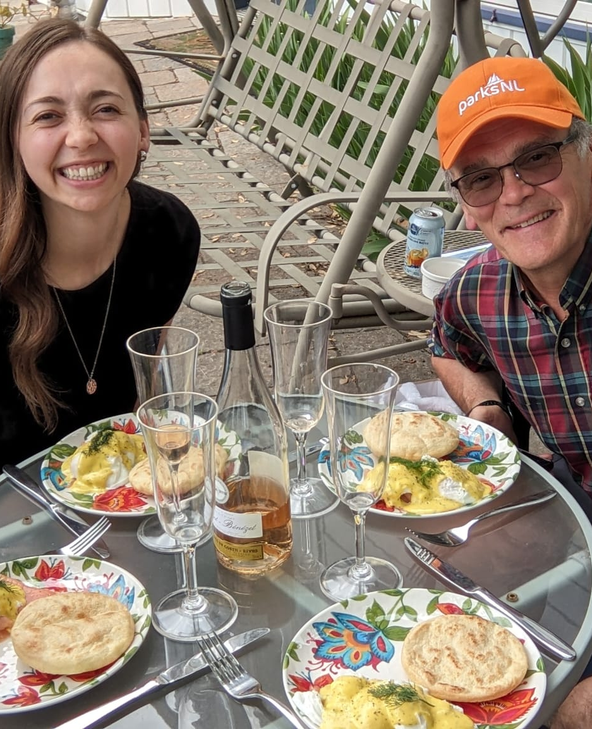
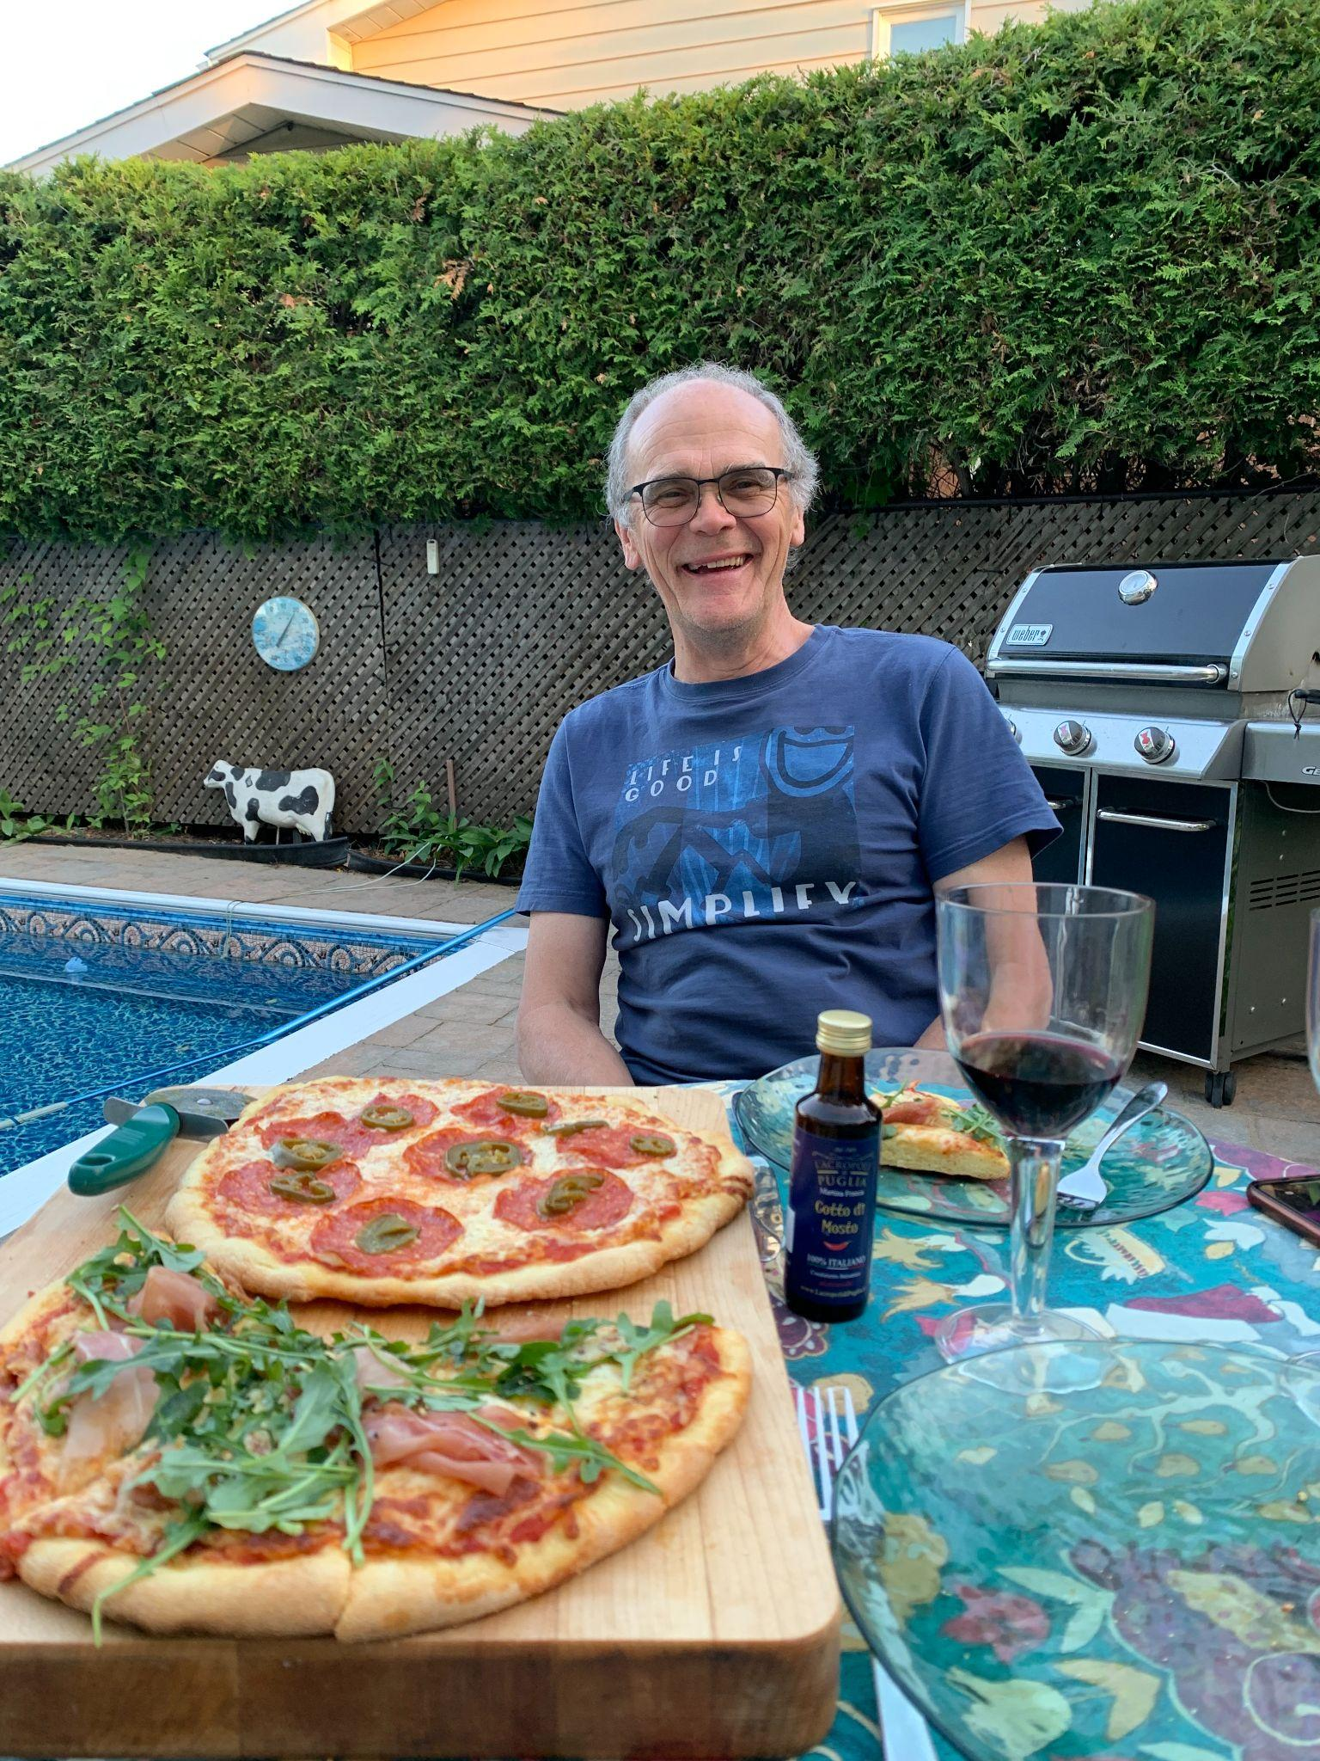
The new era through the lens of food
HOPE
LOVE
GRACE
Growing Food
Making Food
Eating Food

Slide 11
— Mark Twain (1835-1910) American author
Loving Our Neighbour: Sharing food
“If you want love and abundance in your life, give it away.”

Slide 12
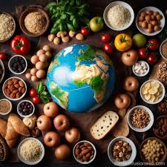
Thanks and Merry Christmas!
Contact us with your questions.
edonbuckingham@gmail.com
+01 613-889-8804
+41 76 690 43 98
jsaez@foodgrainsbank.ca

